Slide 1
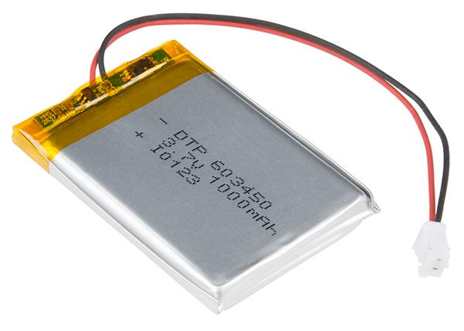


OpenBattery
Project
Yao-Yu Li
Robin Lin
Margherita Taddei
Oliver Zhu

Slide 2


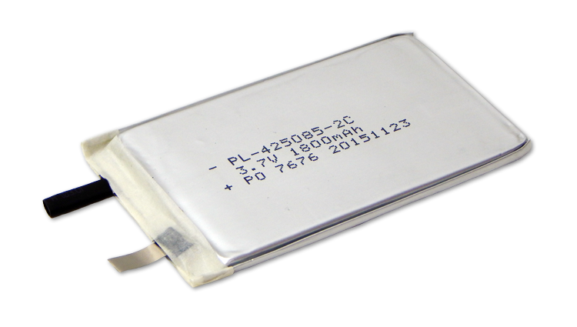
General aspects
Ultimate Goal: Open source battery database available around the world, User will have the permission access. (educational, government, or paid). Customized research of various features of the batteries.
User story: Companies working in electronics, research organization working in clean energy, research students working on new battery materials.
Novelty: Azure, user friendly.
How to proceed: Organize data from cycling experiments on GitHub. Gaining expertise in Azure. Create the user friendly database on Azure.
Notes:
High performance Open Battery Database that operates on the Azure cloud platform.
A well-architected battery database that is easy for others to add data too, and has high performance, will be a
transformational resource to develop and validate machine learning and physics based models for the design,
prediction, and optimization of battery performance under a wide range of use cases.

Slide 3
Progress in the last 2 weeks
Plans for next week
Weekly meet with the Project advisor from Microsoft
Collected the data from Daniel Schwartz research group
Navigate through the data information
Schema
SQL database on Azure draft
Navigate and create the database project into Azure
Focusing on one battery dataset and transfer all the information and draft the schema on GitHub

Slide 4
Ultimate Goal
High performance open source battery database
Novelty:
Azure cloud
User friendly, easy for users to navigate
Can search inside the database based on certain features.
Notes:
A well-architected battery database that is easy for others to add data too, and has high performance, will be a
transformational resource to develop and validate machine learning and physics based models for the design,
prediction, and optimization of battery performance under a wide range of use cases.

Slide 5



User Story
User: Energy company, research institute and so on.
Feature: Looking into variables of interests, such as materials, electrolytes, type of battery
Commercial Value: User can use other user’s approved battery database potentially save money on develop a new one.

Slide 6
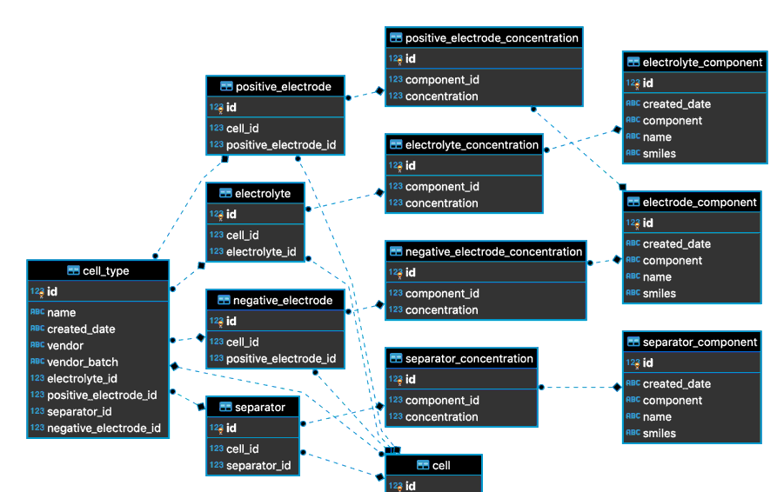
How to proceed
Organize data from cycling experiments on GitHub
Gaining expertise in Azure
Create the user friendly database on Azure

Slide 7
Novelty
Azure
User friendly: people can post their database as long as they have acknowledgment and relative experiment.

